Slide 1
FoodByUs Coding Exam
Gerard Jerome Reyes
October 12, 2023

Slide 2
Links
FoodByUs repo: https://github.com/fbu-code/back-end-interview-prac
Gerard Reyes repo: https://github.com/gerardreyes/back-end-interview-prac

Slide 3
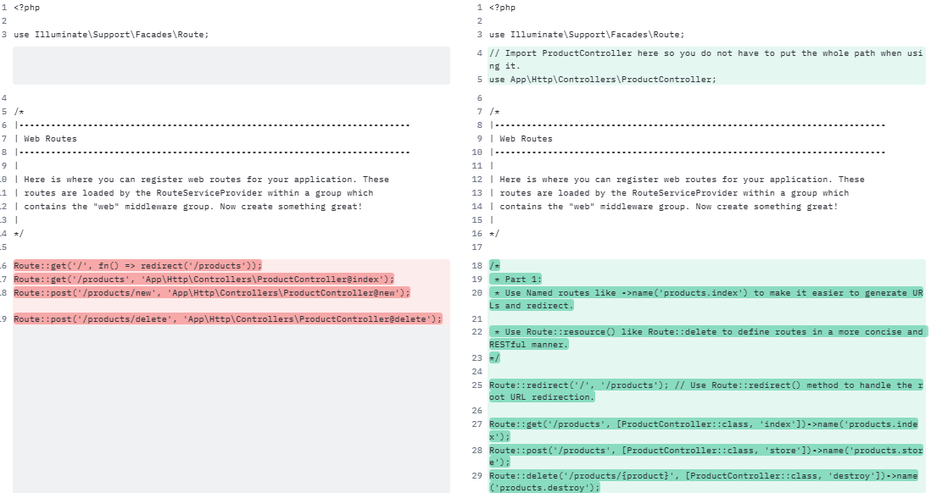
Improve the routing used in the site

Slide 4
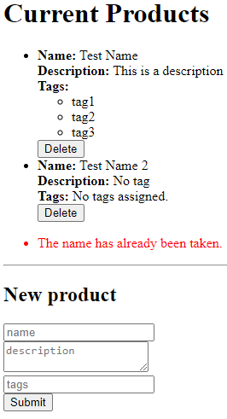
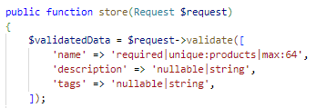
Add validation to the new product process and make sure the product's name is unique

Slide 5


Fix any security issues you notice in the ProductController
SQL Injection Vulnerability:
The new and delete methods in the original code directly query in the database using SQL queries without any validation or sanitization of user input. This leaves your application vulnerable to SQL injection attacks. To fix this, I used Eloquent instead.
Use Laravel's built-in ORM, Eloquent instead of Query Builder to interact with the database. This provides a more expressive and clean way to manage database records.
Raw SQL Query:
Eloquent:

Slide 6
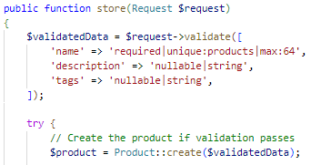
Fix any security issues you notice in the ProductController
No Input Validation:
The original code lacks input validation. It accepts user input without any validation, which can lead to security vulnerabilities and data integrity issues. To fix this, I added an input Validation.
Added Validation by using Laravel's built-in validation system to validate the request data.

Slide 7
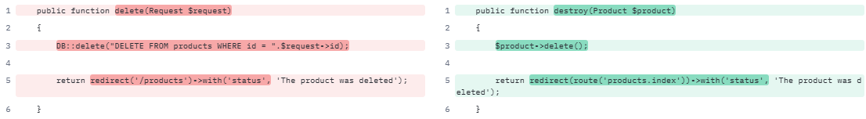
Fix any security issues you notice in the ProductController
Lack of Route Binding:
The delete method expects an id from the request but doesn't specify where it comes from. It is better to use route model binding to automatically inject the model based on the URL parameter.
Instead of delete(Request $request), we can use destroy(Product $product) for type hinting for the Product model.

Slide 8
Fix any security issues you notice in the ProductController
No Authentication and Authorization:
This might not be applicable in this exam since there is no login and logout function. But a good addition to this would be to add authentication or authorization checks for create and delete methods.

Slide 9
Improvement for ProductController
Naming Conventions:
Use proper naming conventions for methods like create instead of new to match RESTful resource naming.
Use Named Routes for redirecting. This makes the code more readable and maintainable.
From public function new(Request $request) to public function store(Request $request)
From public function delete(Request $request) to public function destroy(Product $product)
From return redirect('/products')->with('status', 'The product was saved’); to return redirect(route('products.index'))->with('status', 'The product was saved');

Slide 10
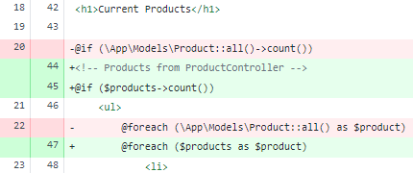
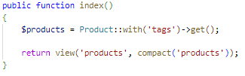
Fix any security issues or bugs, and make improvements to the blade template
Model Query in Blade Template:
Using App\Models\Product::all() to retrieve Products is not a recommended practice.
Instead, you should pass the Products data from your Controller to the Blade template.
It's more efficient and follows the MVC pattern.

Slide 11
Fix any security issues or bugs, and make improvements to the blade template
Input Validation for Form Fields:
You should consider adding validation rules to your form fields.
For example, you can use the required and max rules for the "name" field.
This will help ensure data integrity and security.
From: <input type="text" name="name" placeholder="name" /><br />
To: <input type="text" name="name" placeholder="name" required max=64/><br />

Slide 12
Fix any security issues or bugs, and make improvements to the blade template
Displaying HTML Tags:
Using {!! $product->name !!} outputs data without escaping it.
If Product Names contain HTML or script tags, it could potentially lead to a Cross-Site Scripting (XSS) vulnerability.
You should use {{ $product->name) }} to escape the any HTML or special characters within the variable.
From: <strong>Name:</strong> {!! $product->name !!}<br>
To: <strong>Name:</strong> {{ $product->name }}<br>

Slide 13
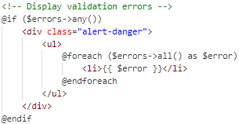
Fix any security issues or bugs, and make improvements to the blade template
Error Handling:
Consider adding error handling to your form submissions.
If there's an error during form submission (e.g., database insert fails), you should provide feedback to the user.

Slide 14
Fix any security issues or bugs, and make improvements to the blade template
Consider Using Named Routes:
Instead of hardcoding URLs in your forms, consider using named routes for better maintainability.
From: <form action="/products/new" method="POST">
To: <form action="{{ route('products.store') }}" method="POST">

Slide 15
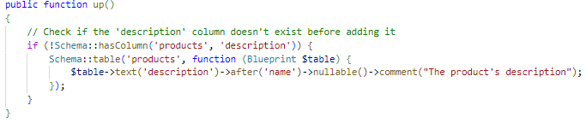

Currently, the "description" field in the form doesn't do anything
Please update the products table to include a "description" field, and populate it from this form.
Create a migration to add `description` to the `products` table:
Add `description` into `Product` Model’s $fillable:

Slide 16
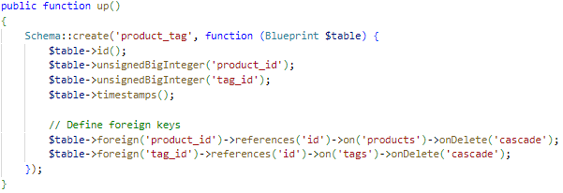
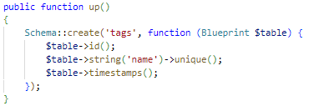


Currently, the "tags" field in the form doesn't do anything. We would like to create tags for new products:
Create a new Tag model, and a new pivot table to link the Products to the Tags (many-to-many):
Create migrations:
Many-to-many relationship between the Product model and the Tag model

Slide 17
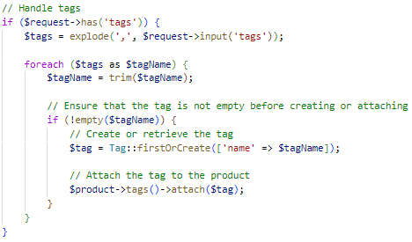
Currently, the "tags" field in the form doesn't do anything. We would like to create tags for new products:
Take the tags string when the form is submitted and split it by commas:
Create a tag for each save it - but only if it's unique:
Link the product to each one (whether the tags were new or existed from before):

Slide 18
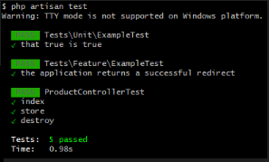
Unit Test
php artisan test

Slide 19
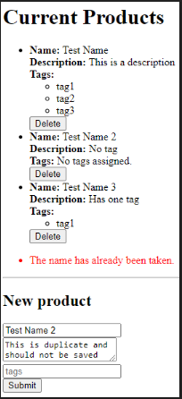
UI

Slide 20
The End
Thank you!

